Slide 1

Workstation Tutorial
2017-10-26
Presenter: Yu-Sheng Lu
Algorithms, Fall 2017
Instructor: Hui-Ru Iris Jiang
The Electronic Design Automation Laboratory
Graduate Institute of Electronics Engineering
National Taiwan University
Taipei 106, Taiwan

Slide 2
Outline
EDAunion Workstation
Bash commands
Compiler & Makefile
Vim
Online resources

Slide 3
EDAunion Workstation
Available server list:
http://edaunion.ee.ntu.edu.tw/ws_list.htm
Student account
alg17+<number>
Ex: alg1780
Login command
ssh <account>@edaunion.ee.ntu.edu.tw –p <port number>
Ex: ssh alg1780@edaunion.ee.ntu.edu.tw –p 40065

Slide 4
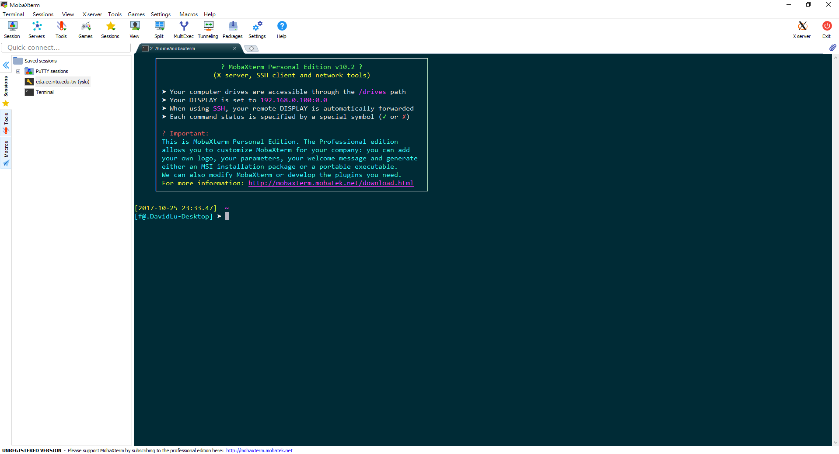
Terminal Consoles
Windows
MobaXterm: https://mobaxterm.mobatek.net/
Putty: http://www.putty.org/
Pietty: https://sites.google.com/view/pietty-project
Linux
Default terminal

Slide 5
Terminal Commands
Commands you MUST know
yppasswd
ls
cd
mkdir
rm
mv
tar
…

Slide 6
Compiler & Makefile
Compiler
Compile your program using “commands” instead of “buttoms”
g++, clang, …
Command: g++ <file name> -o <program name>
Ex: g++ -O2 main.cpp –std=c++11 –o PA1
Makefile
Fast compile script for large and complex software
Command: make, make clean, make debug (how?)

Slide 7
Vim
A very powerful & elegant text editor on Linux OS
Commands
Insertion mode, view mode, visual mode switching
Esc, i, v
Save & Quit
:w, :q
Copy & paste
yy, p
Auto indent
???
Environment setting
.vimrc

Slide 8
Online Resources
Command line
Basic
http://linux.vbird.org/linux_basic/
Compress file
http://note.drx.tw/2008/04/command.html
Compiler & Makefile
http://beyond-firmware.blogspot.tw/2014/12/c-compiler-g.html
http://www.laird.tw/2015/04/linux-c-ubuntu-c.html
https://dywang.csie.cyut.edu.tw/dywang/linuxProgram/node58.html
http://www.csie.nuk.edu.tw/~kcf/course/97_Spring/Embedded%20System/8-Makefile.pdf
Vim:
http://linux.vbird.org/linux_basic/0310vi.php
Reference book
C++ Primer, C++ Primer Plus, …

